Slide 1
New Unified PO Line Task List
Yoel Kortick
Senior Librarian

Slide 2

Agenda
Introduction
The Menu
Task List as Facets
Existing Task List Menu Links for PO Line Task Lists
Multi-Select Facets
Sensitive Top List Actions
Clear Information Hierarchy
Presentation Toggle Button
Split View (Side By Side View)
Slide-Out Panel
Receiving Items from within the PO Line
The "Items In Claim" Section
The clickable "Sent" Status
Sorting and Labels

Slide 3
Introduction

Slide 4
Introduction
In addition to this presentation see also The New Unified PO Line Task List.
The New Unified PO Line Task List is part of a larger improvement initiative under the umbrella of "an enhanced user experience across Alma navigation".
This initiative is a result of cooperation with Alma working groups and a response to the wider community feedback.
For more information regarding this larger initiative, see Usability Improvements.

Slide 5
The Menu

Slide 6
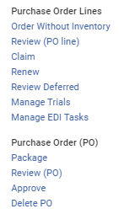
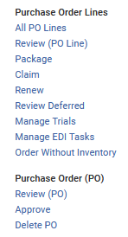
The new menu
Existing menu
New menu
A new entry "All PO Lines" has been added to "Purchase Order Lines"
"Package" has been moved from "purchase Order (PO)" to "Purchase Order Lines"

Slide 7
Task List as Facets

Slide 8
Task List as Facets
The presentation of the various assignment options as facets (Unassigned, Assigned to me, Assigned to others) enables the user to search for PO lines and immediately work on them (without the extra step of "Go to task list").
After selecting "Acquisitions > Purchase Order Lines > All PO Lines" there is a list of all PO Lines and facets by assignment.
The new "All PO lines" menu link allows the staff user to view all PO lines of all types and workflow steps (statuses).

Slide 9
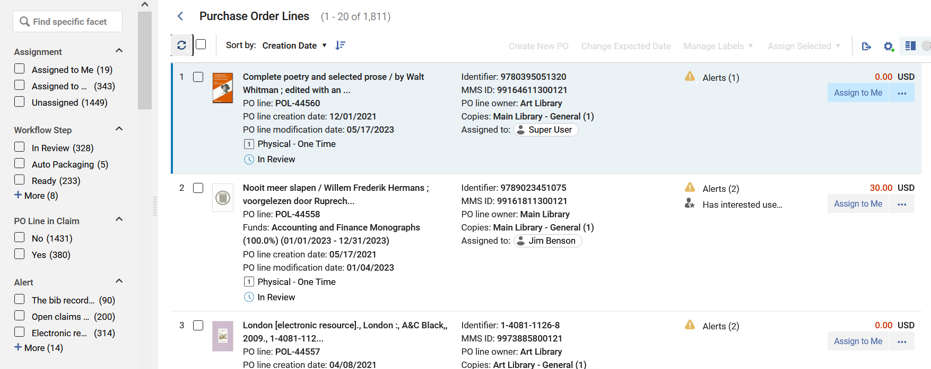
Task List as Facets
New faceted task list

Slide 10
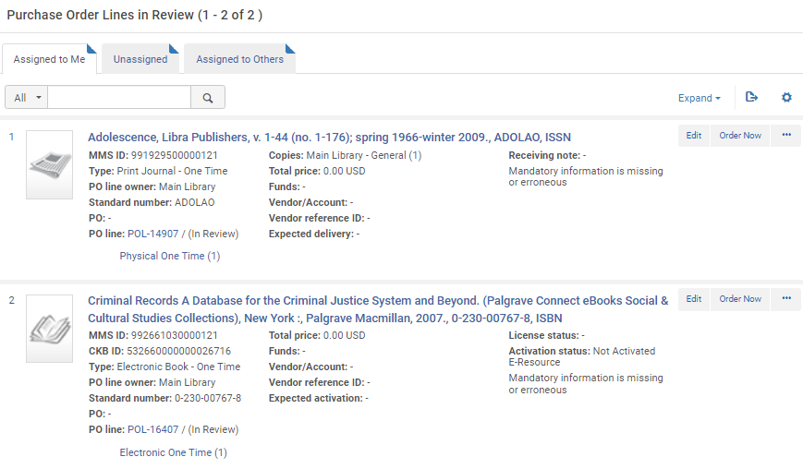
Task List as Facets
Existing tabbed task list

Slide 11
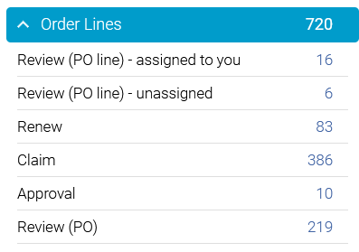
Task List as Facets
The new PO Line task list also appears when accessing from the task list in the upper right menu
For example, we will choose "Review (PO Line) – unassigned"

Slide 12
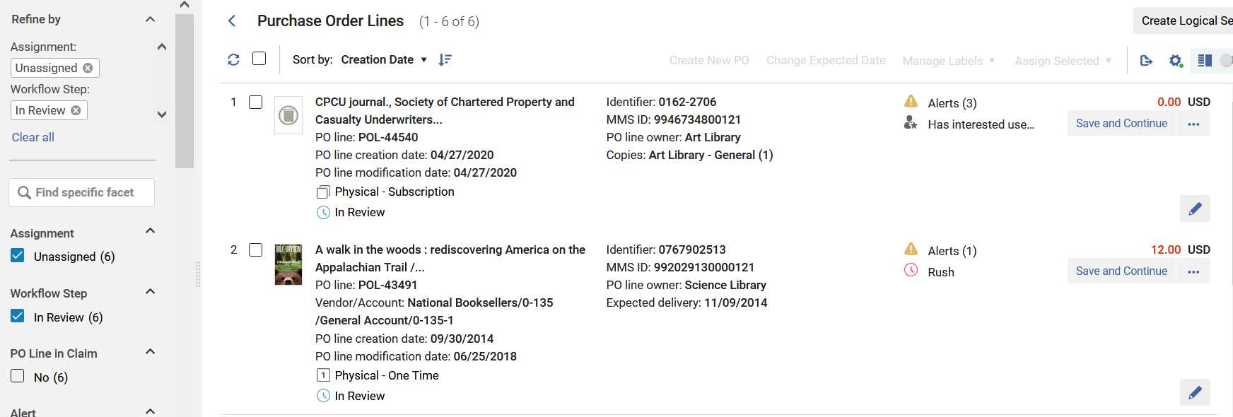
Task List as Facets
Because we chose "Review (PO Line) – unassigned" it is pre-faceted by "Assignment: Unassigned" and "Task Name: In Review"

Slide 13
Task List as Facets
Regarding the assignment of PO Lines:
  Previously (in older UI) when a user edited a PO Line it would become assigned to that user.
  This functionality of “Auto assignment” (assigning the PO line to the user if he or she clicked “Edit”) has been deprecated.
  Now a PO Line does not become automatically assigned to a user who edits the PO Line.

Slide 14
Existing Task List Menu Links for PO Line Task Lists

Slide 15
Existing Task List Menu Links for PO Line Task Lists
Existing Task List Menu Links for PO Line Task Lists remain and navigates the user to the new unified task list with the relevant facets pre-selected.
These include:
  In-Review
  Package
  Renew
  Review Deferred

Slide 16
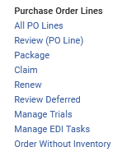
Existing Task List Menu Links for PO Line Task Lists

Slide 17
Existing Task List Menu Links for PO Line Task Lists
In Review
When we click "Review (PO Line)" we get the same list as if we clicked "All PO Lines" but it is pre-faceted by:
  Assignment: Assigned to Me
  Task Name: In Review

Slide 18
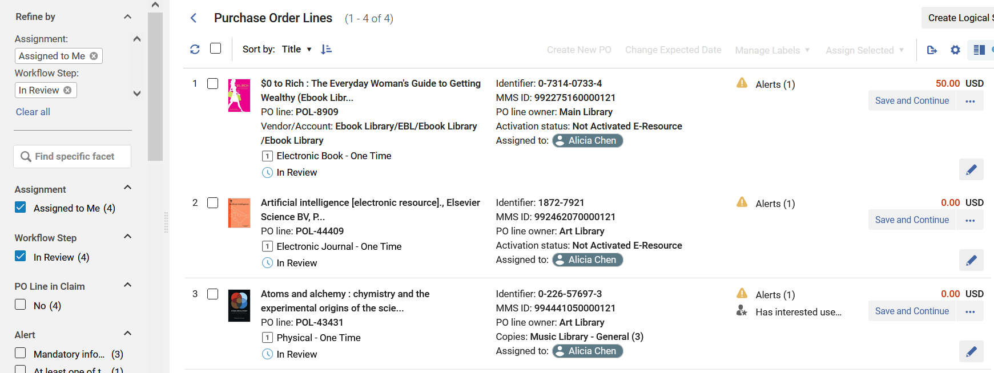
Existing Task List Menu Links for PO Line Task Lists
(I am logged in as Alicia Chen)

Slide 19
Existing Task List Menu Links for PO Line Task Lists
Package
When we click "Package" we get the same list as if we clicked "All PO Lines" but it is pre-faceted by:
  Task Name: Manual Packaging

Slide 20
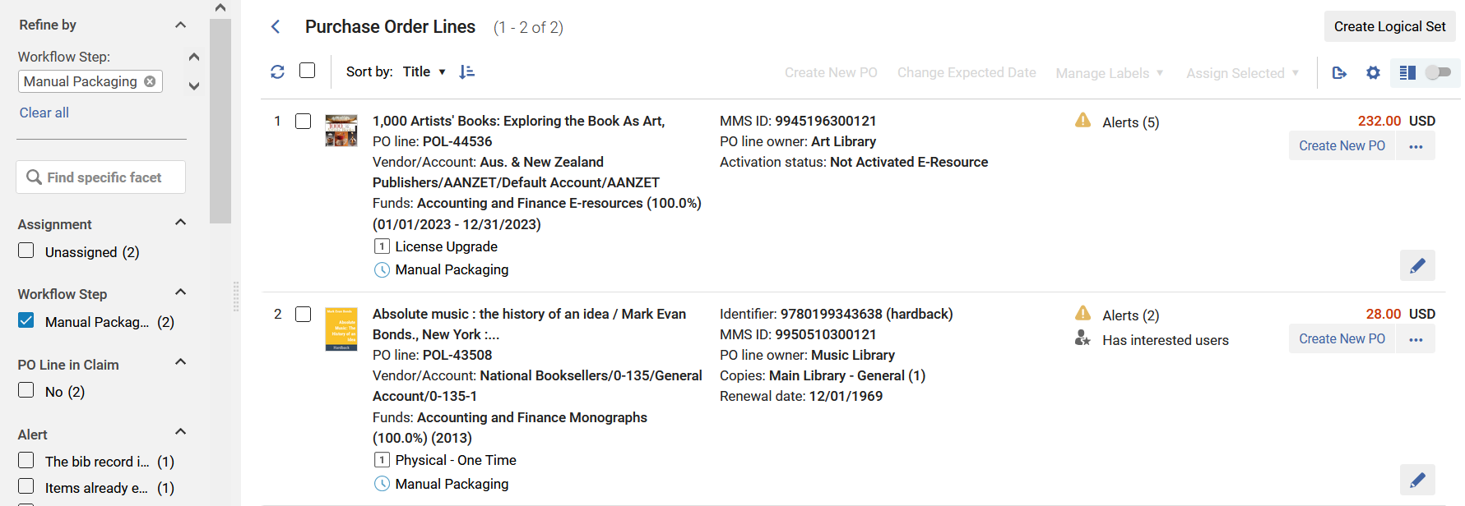
Existing Task List Menu Links for PO Line Task Lists

Slide 21
Existing Task List Menu Links for PO Line Task Lists
Renew
When we click "Renew" we get the same list as if we clicked "All PO Lines" but it is pre-faceted by:
  Task Name: Waiting for Manual Renewal

Slide 22
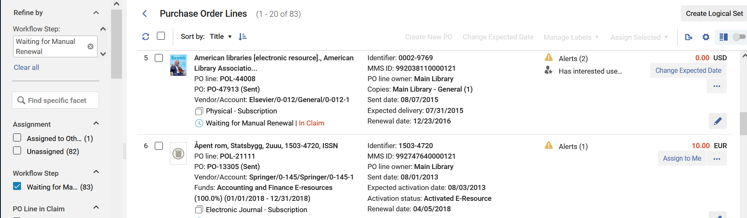
Existing Task List Menu Links for PO Line Task Lists
Note also the “In Claim” indication (which is also a link)

Slide 23
Existing Task List Menu Links for PO Line Task Lists
Review Deferred
When we click "Review Deferred" we get the same list as if we clicked "All PO Lines" but it is pre-faceted by:
  Assignment: Assigned to Me
  Task Name: Deferred

Slide 24
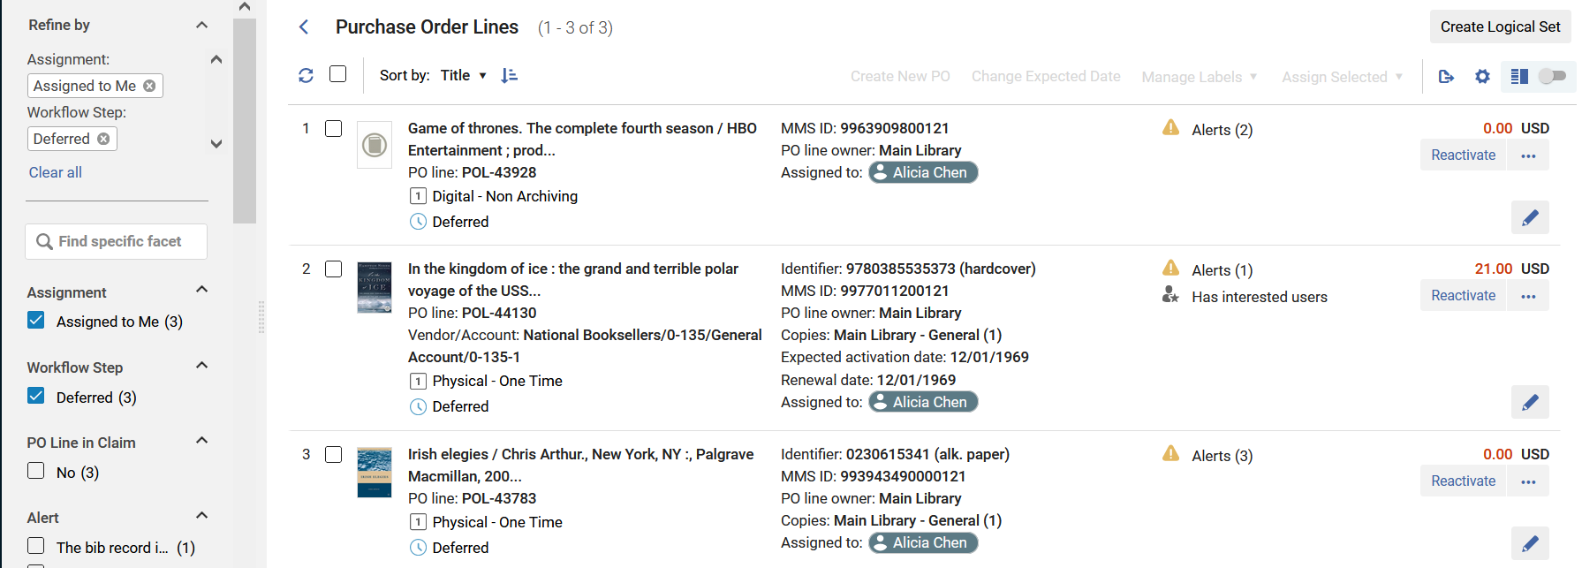
Existing Task List Menu Links for PO Line Task Lists

Slide 25
Multi-Select Facets

Slide 26
Multi-Select Facets
PO line search results are presented in a single page, holding all the various PO line statuses and tasks.
After selecting "Acquisitions > Purchase Order Lines > All PO Lines" there is a list of (as the name suggests) all PO Lines.
All PO Lines can be faceted by a myriad of areas.
It is possible to facet by one parameter or by multiparameters.

Slide 27
Multi-Select Facets
The staff user can facet by all PO Lines by
  Assignment
  Workflow Step
  PO Line in Claim
  Alert
  Purchase Type
  Vendor
  Rush
  Owning Library
  Assigned User
  Acquisition Method
  Reporting Code

Slide 28
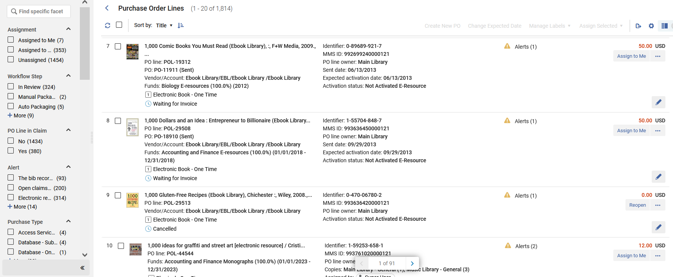
Multi-Select Facets

Slide 29
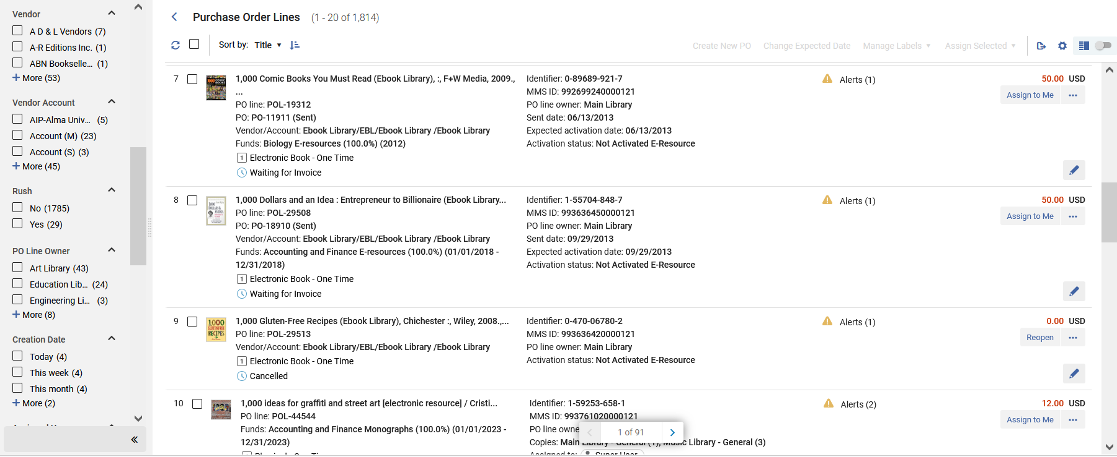
Multi-Select Facets

Slide 30
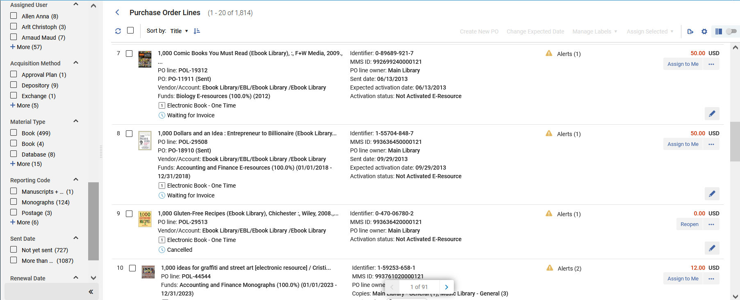
Multi-Select Facets

Slide 31
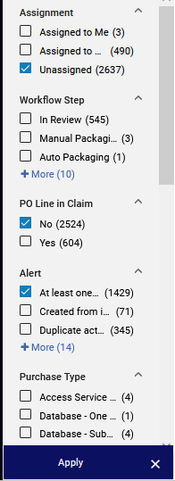
Multi-Select Facets
Multiple facets can be chosen simultaneously and then applied, allowing the staff user to arrive to a very specific group of PO Lines.
Apply the facets

Slide 32
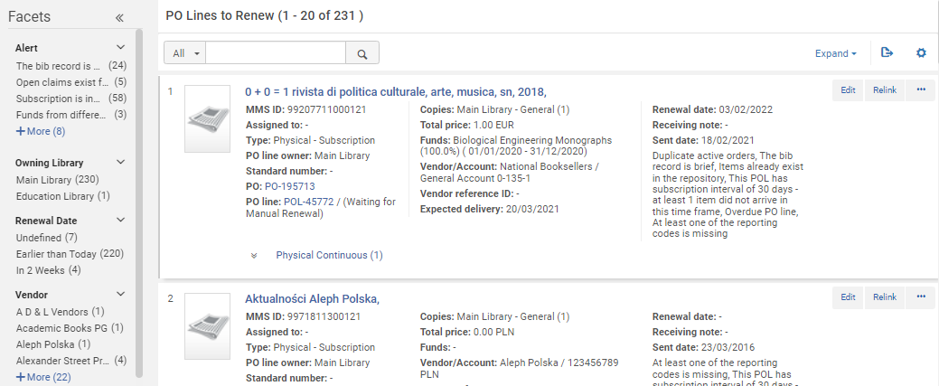
Multi-Select Facets
In the old PO Line list only one facet could be clicked (selected) at a time
Can only click one facet at a time

Slide 33
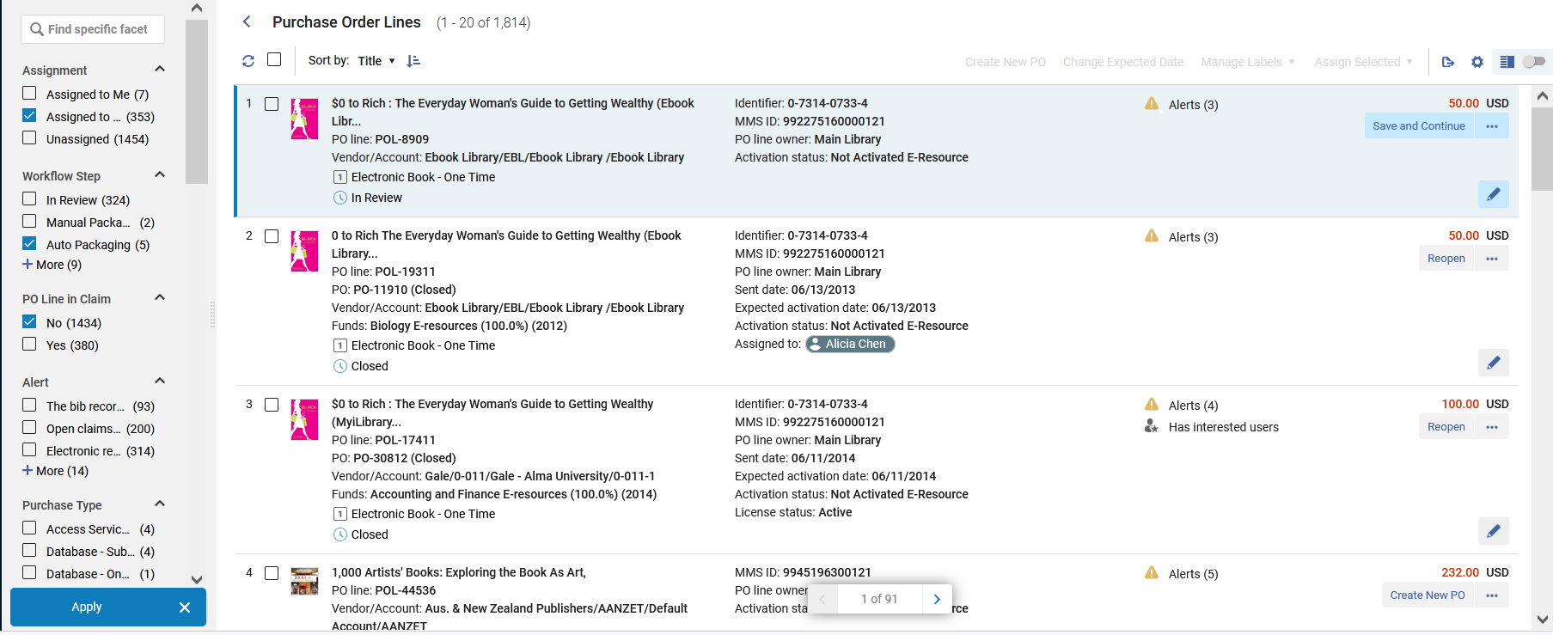
Multi-Select Facets
In the new PO Line list multiple facets can be selected and applied at once
Can choose multiple facets at a time
Apply the facets

Slide 34
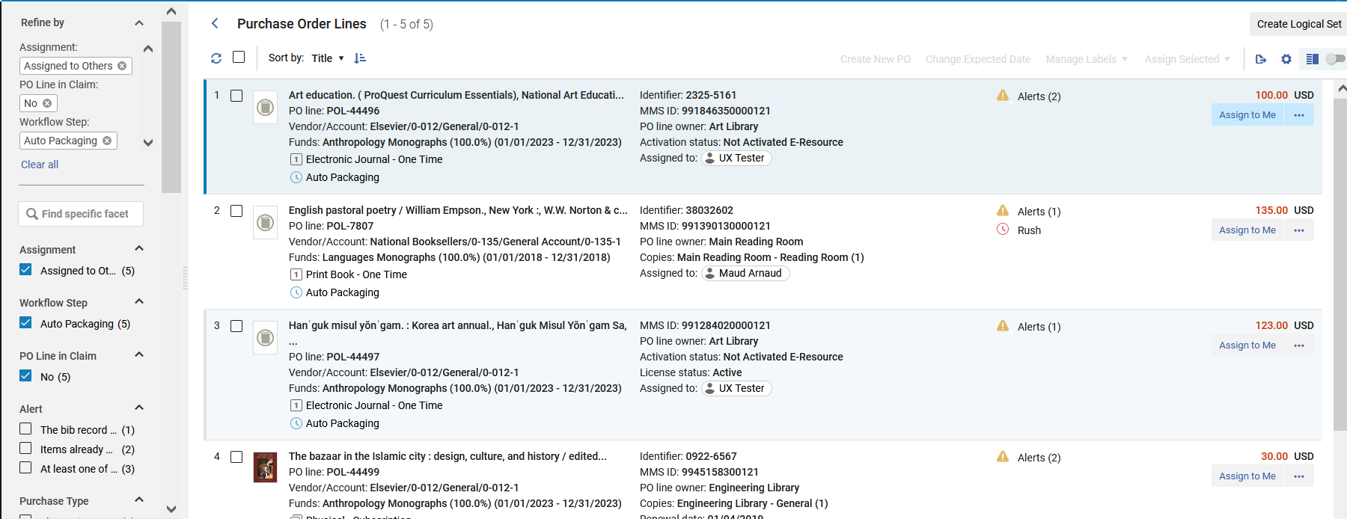
Multi-Select Facets
All three facets have been applied

Slide 35
Multi-Select Facets
On the next slide, for example, we have faceted by all PO Lines which are
  Assignment: Assigned to Others
  PO Line in Claim: No
  Workflow Step: Auto Packaging
  Vendor: Elsevier

Slide 36
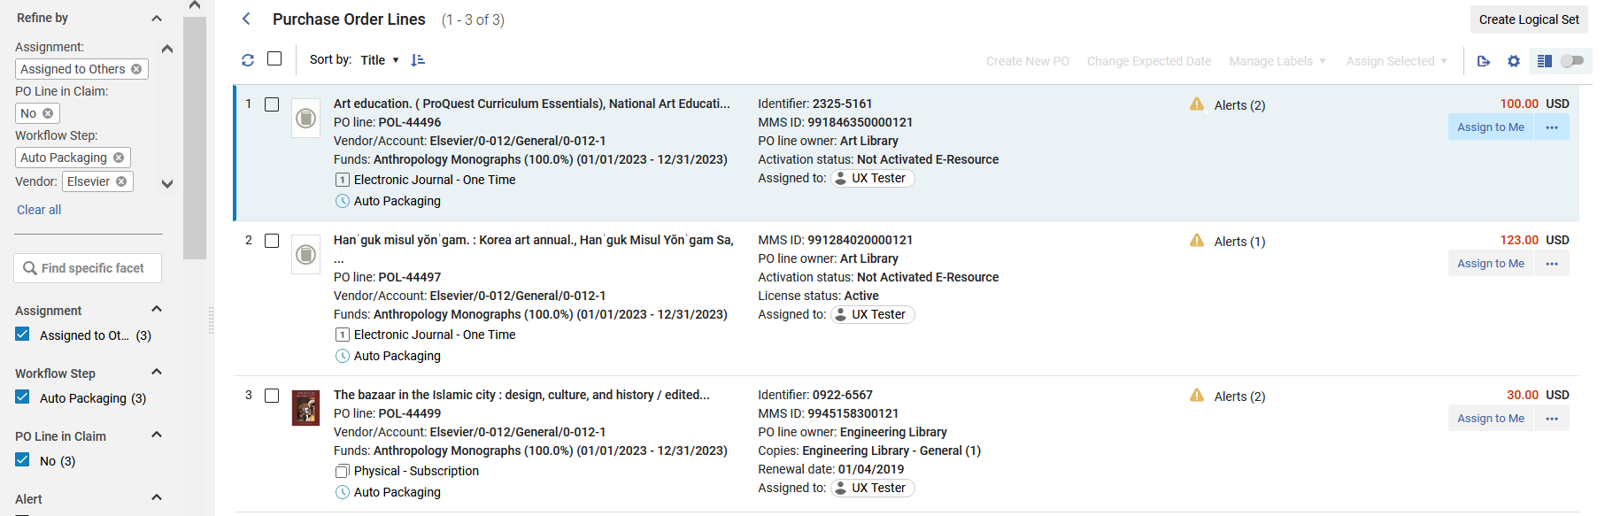
Multi-Select Facets

Slide 37
Sensitive Top List Actions

Slide 38
Sensitive Top List Actions
The actions presented on top of the search results list ("Create New PO", "Change Expected Date" and "Manage Labels") are sensitive to the selection of the user.
When one or more PO lines are selected, the top list actions are enabled.
The list actions are:
  Create new PO - This action allows packaging multiple PO lines for which their workflow step is "Manual-Packaging" into a PO.
  Change Expected Date - This action allows modifying multiple the PO lines and setting their "expected receipt date".
  Manage Labels - This action allows the user to add/remove labels from multiple PO lines at once.
  Assign Selected - Assign the POLs to a specific user

Slide 39
Sensitive Top List Actions
In a situation in which the staff user selects to run an operation on a PO line which does not support the specific action (for example "Create New PO" for PO line in workflow step is not "Manual Packaging") the operation will skip this PO line and an appropriate message will appear.
We will see this soon.

Slide 40
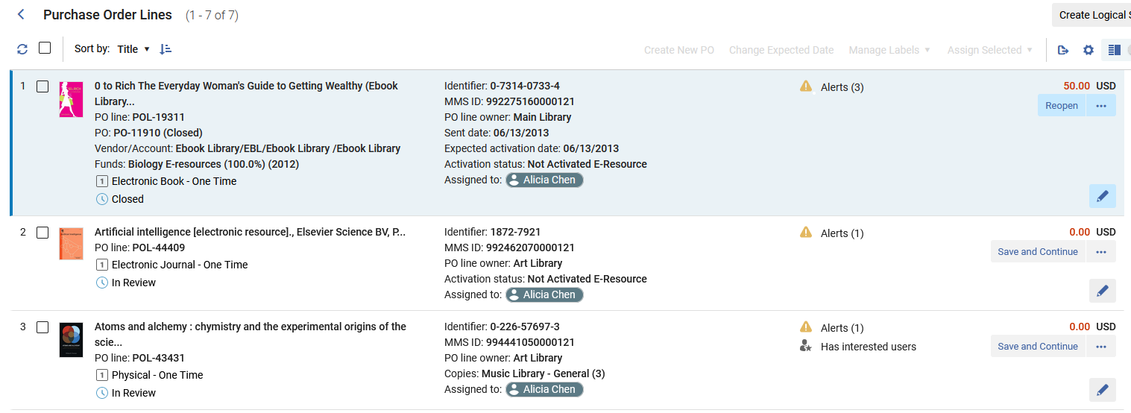
Sensitive Top List Actions
Here we see that no POLs are selected so the "Top List Actions" are not active
Actions are not active

Slide 41
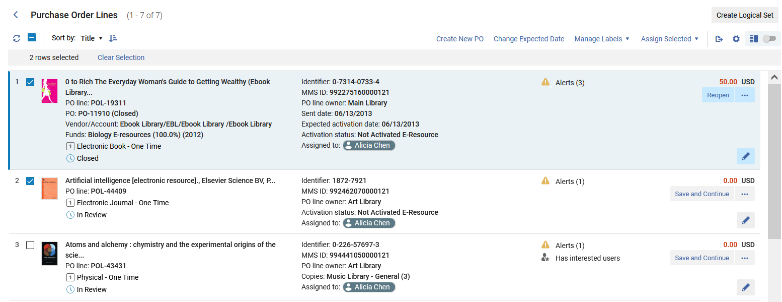
Sensitive Top List Actions
Now one or more POLs are selected so the "Top List Actions" are active

Slide 42
Sensitive Top List Actions
Now we will perform the action "Create New PO" on two PO Lines.
One is in workflow step "Manual Packaging", and one is in workflow step "Sent".

Slide 43
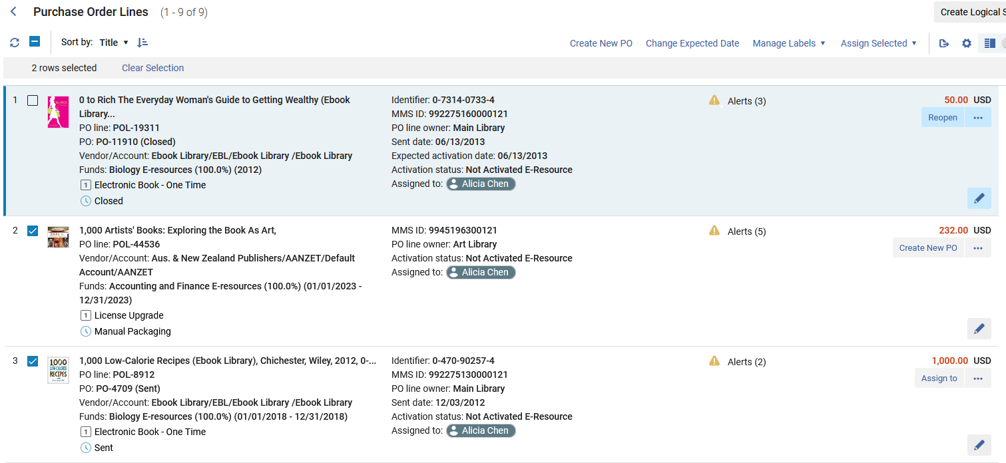
Sensitive Top List Actions

Slide 44
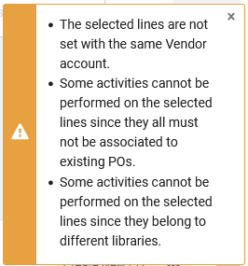
Sensitive Top List Actions
We receive an explanatory message that a new PO could not be created for all PO Lines.

Slide 45
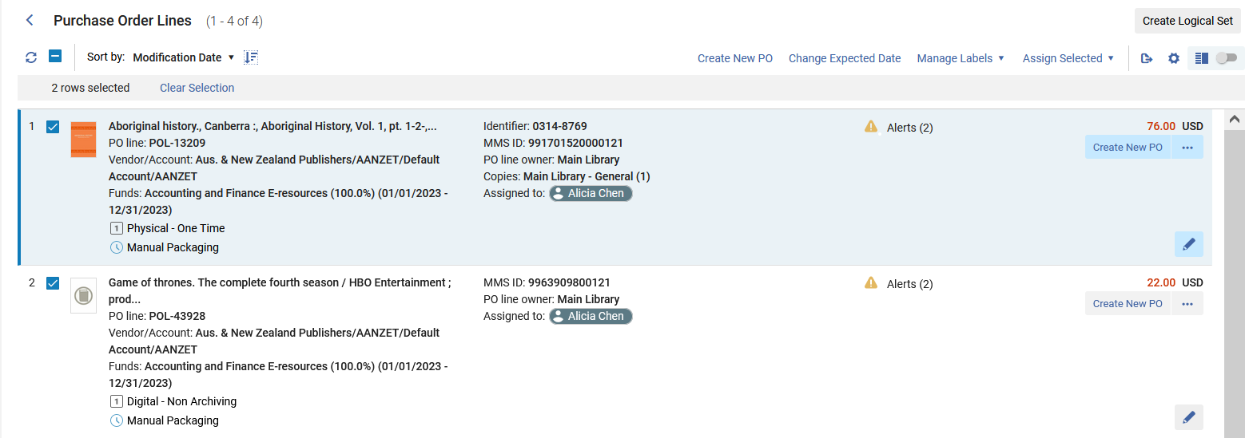
Sensitive Top List Actions
Now we will choose two different POLs and again click "Create New PO"

Slide 46
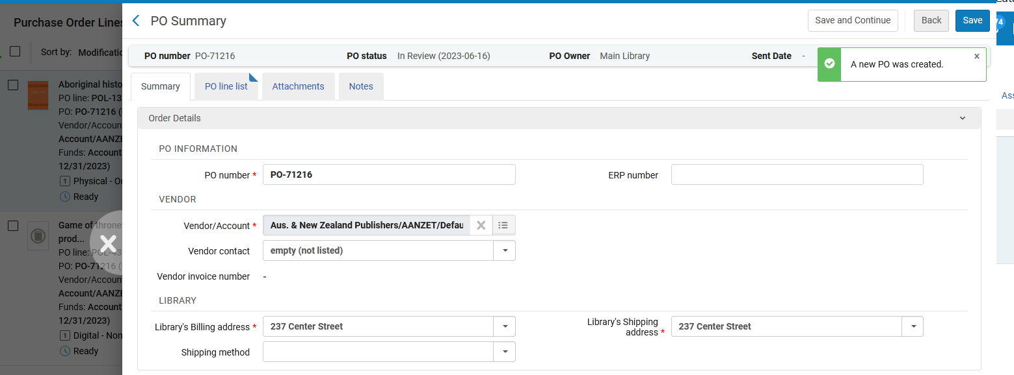
Sensitive Top List Actions
A new PO is created. It appears in the "Slide-Out Panel" (which we will talk about later)

Slide 47
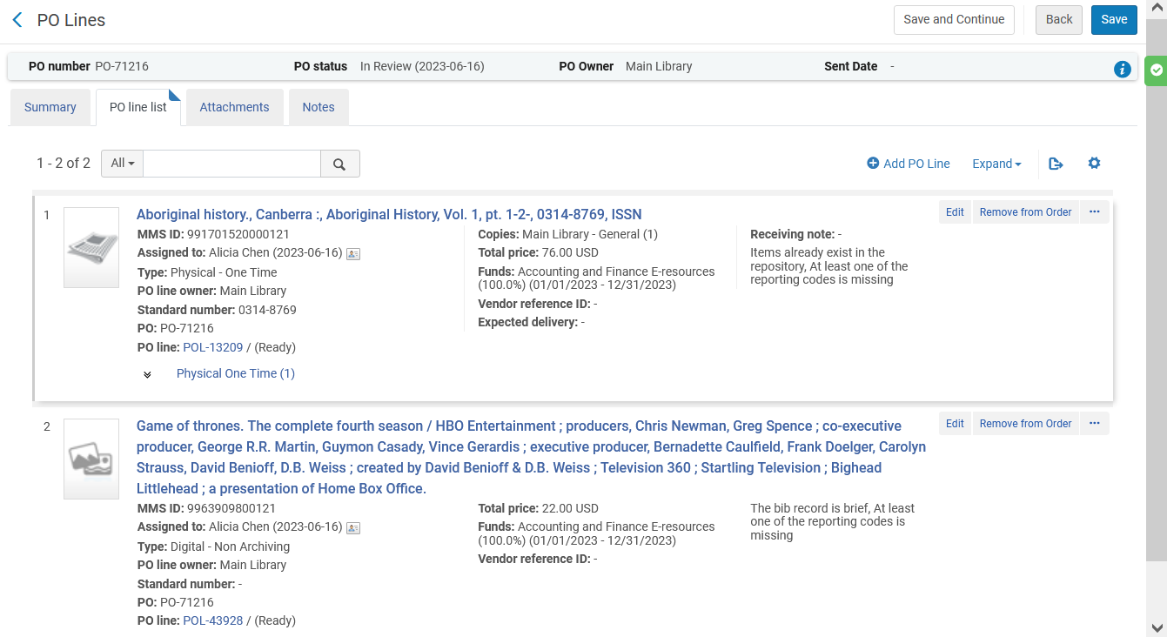
Sensitive Top List Actions
The new PO is created with both PO Lines.

Slide 48
Clear Information Hierarchy

Slide 49
Clear Information Hierarchy
The New Unified PO Line Task List contains a clearer and more prominent information hierarchy of the PO line search results.
This enables Acquisitions staff users who are reviewing the PO line's search results list to find what they need faster and with less navigation needs.

Slide 50
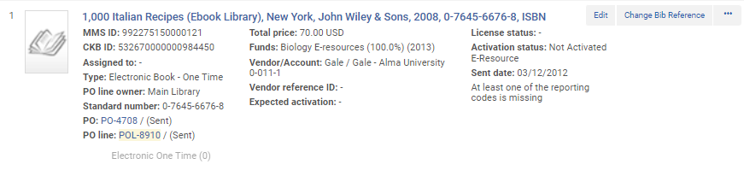
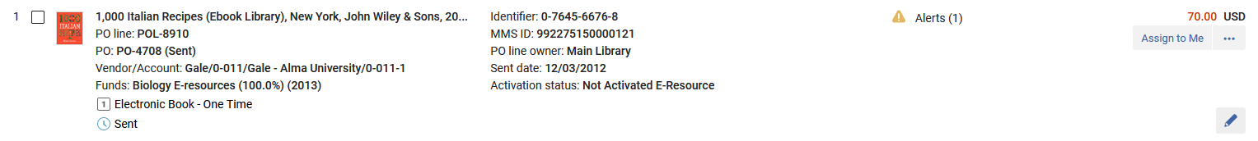
Clear Information Hierarchy
Separation between the PO line's identifier and status.
Old
Identifier and status on one line
New
Identifier and status on two separate lines

Slide 51
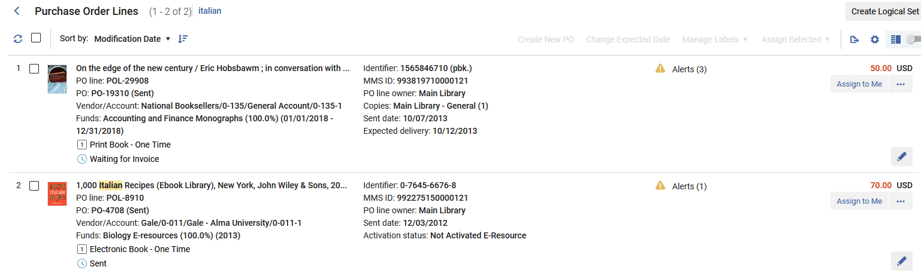
Clear Information Hierarchy
Permanent location for the PO line's type and status.

Slide 52
Clear Information Hierarchy
Fixed location to the PO line's price (on top of the main record action).

Slide 53
Clear Information Hierarchy
Fund and vendor (first column) provides staff overview on mandatory information.

Slide 54
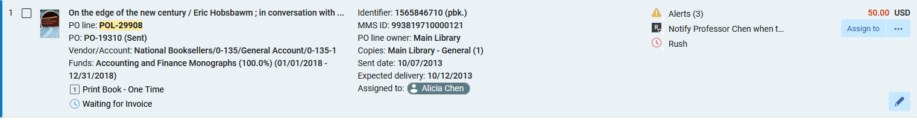
Clear Information Hierarchy
Addition of icons for Alerts, Receiving note, and Rush improves the user's ability to quickly focus on the needed information within the PO line record.

Slide 55
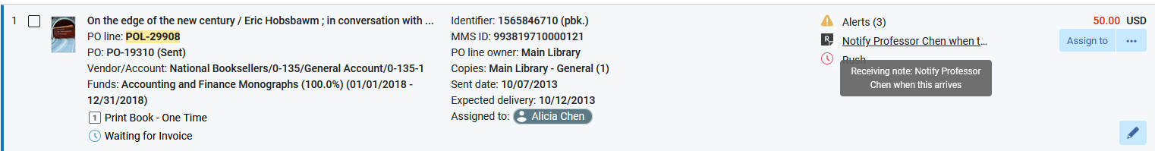
Clear Information Hierarchy
Hovering on the receiving note shows the full note without needing to "enter" the PO Line.

Slide 56
Clear Information Hierarchy
PO Line Assignment Status
As the new PO line list supports assignment functionality for all types of PO lines (excluding PO lines in "Closed" and "Cancelled" workflow steps), a clear indication on the PO line record enables users to quickly understand the PO line assignment status:
"Assigned to Me" PO lines will have a dark grey badge indicating to the user that the PO line is assigned to them
"Assigned to Others" PO lines will have a white badge indicating to the user that the PO line is assigned to another user
"Unassigned" PO lines will have no indication badge

Slide 57
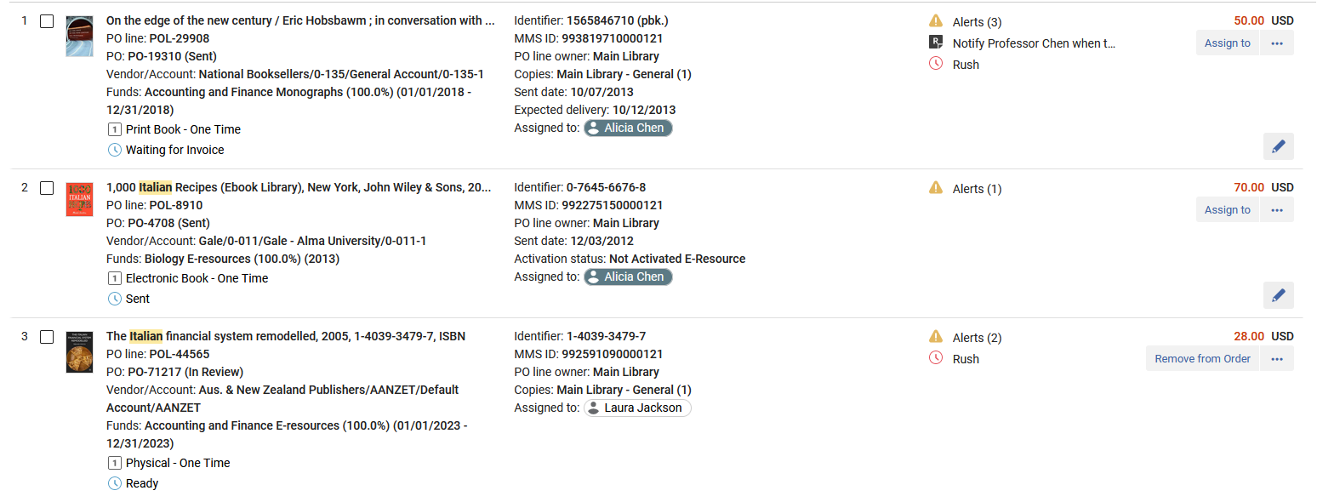
Clear Information Hierarchy
Dark Grey Badge means "Assigned to me". (I am logged in as Alicia Chen).
White Badge means "Assigned to another user"

Slide 58
Presentation Toggle Button

Slide 59
Presentation Toggle Button
The presentation toggle button is located on the top right corner of the page and enables users to determine the way the PO line is presented on the screen.
This allows users to work in the best way that suits their specific individual needs.

Slide 60
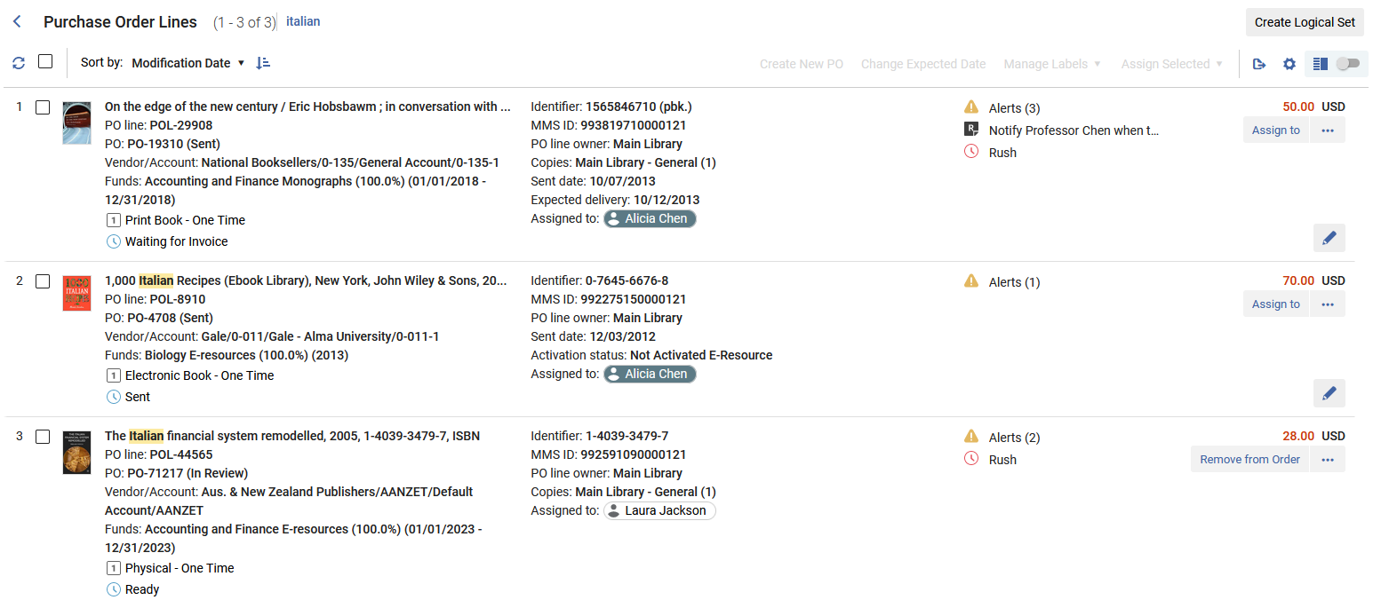
Presentation Toggle Button
Presentation Toggle Button

Slide 61
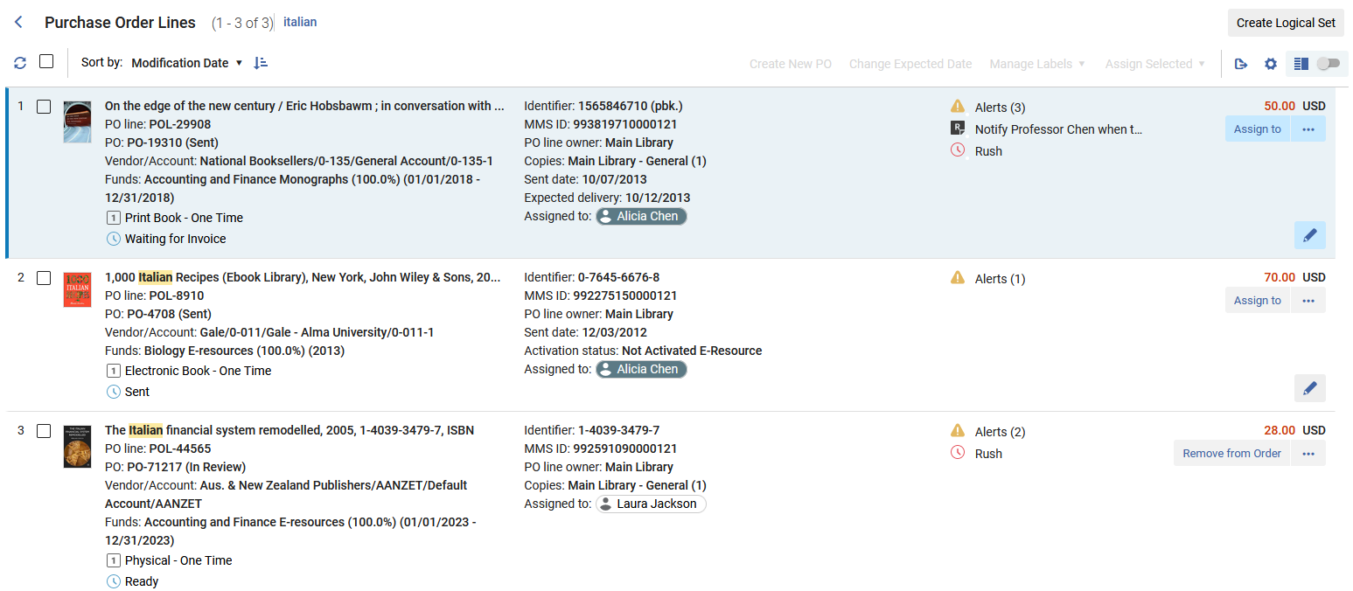
Presentation Toggle Button
Not toggled to Split View
This is the list view

Slide 62
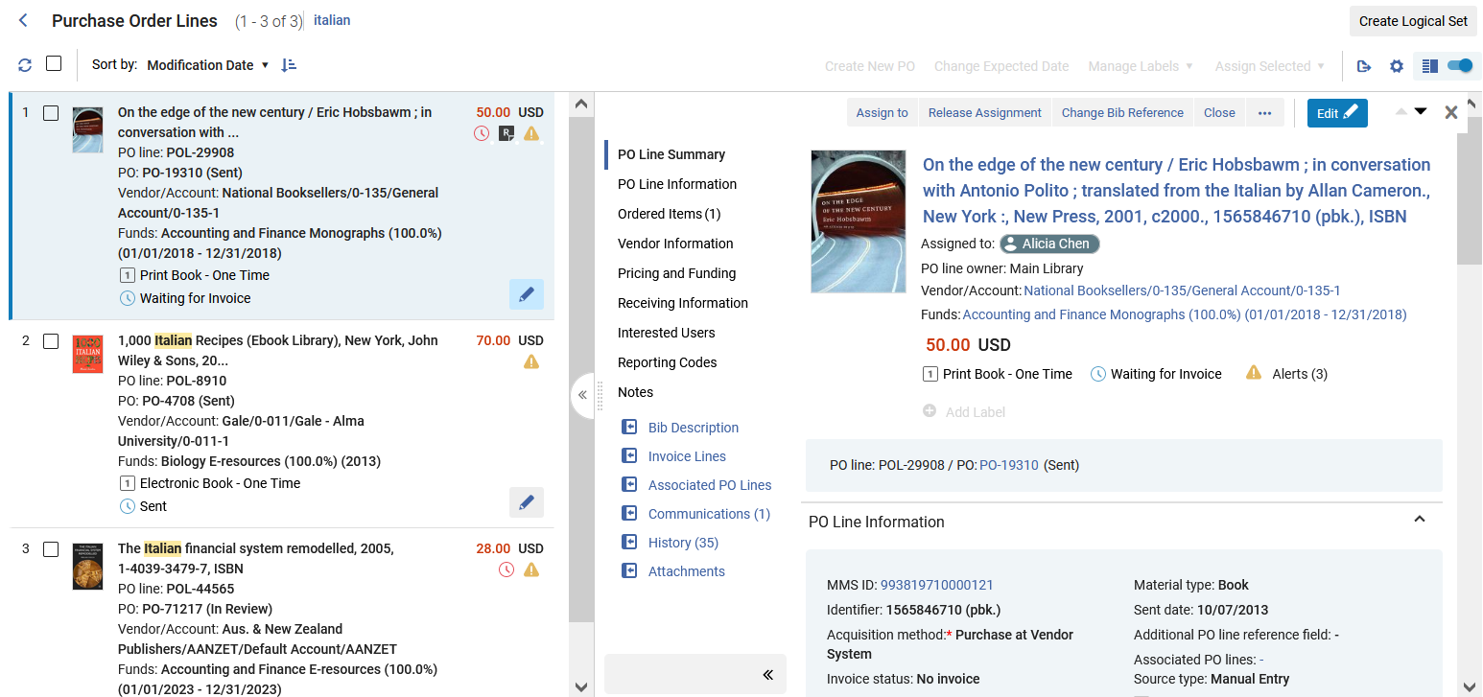
Presentation Toggle Button
Toggled to Split View
This is the split view
Pane divider can be dragged left or right to show more or less on a specific side.
Left pane can be collapsed here

Slide 63
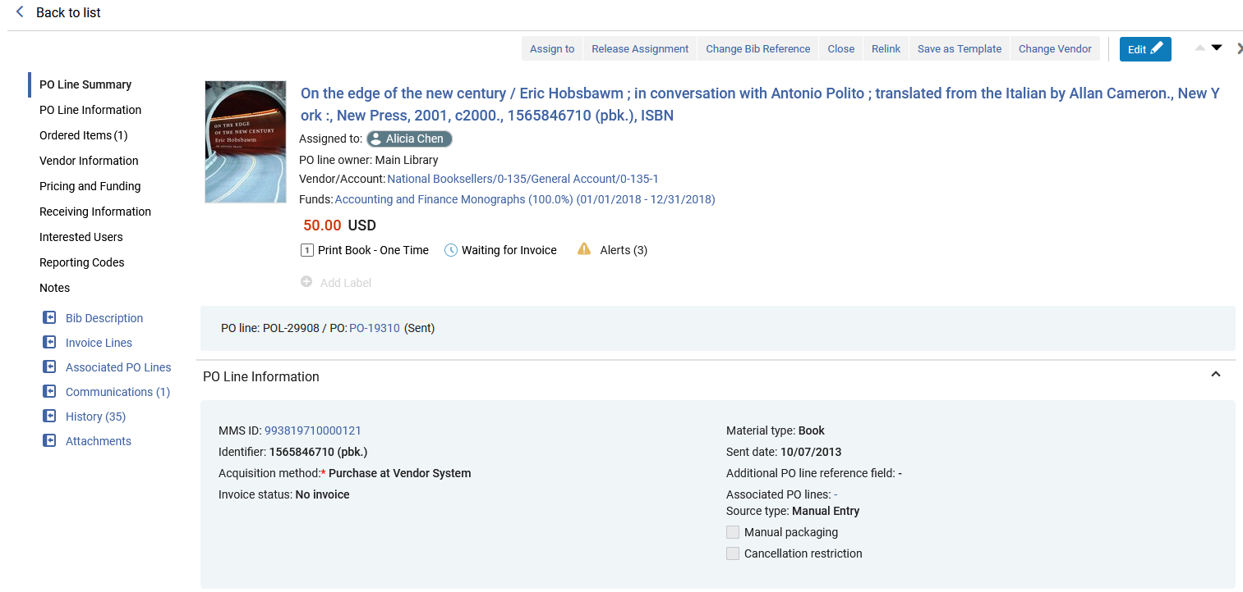
Presentation Toggle Button
Two ways to get to the full-page view (access by clicking a POL from the List View)

Slide 64
Presentation Toggle Button
There are two ways to get to the full-page view from the split screen view
Click the “Disable split screen” button on the top right
Click the “Open full page view” icon in the middle of the screen

Slide 65
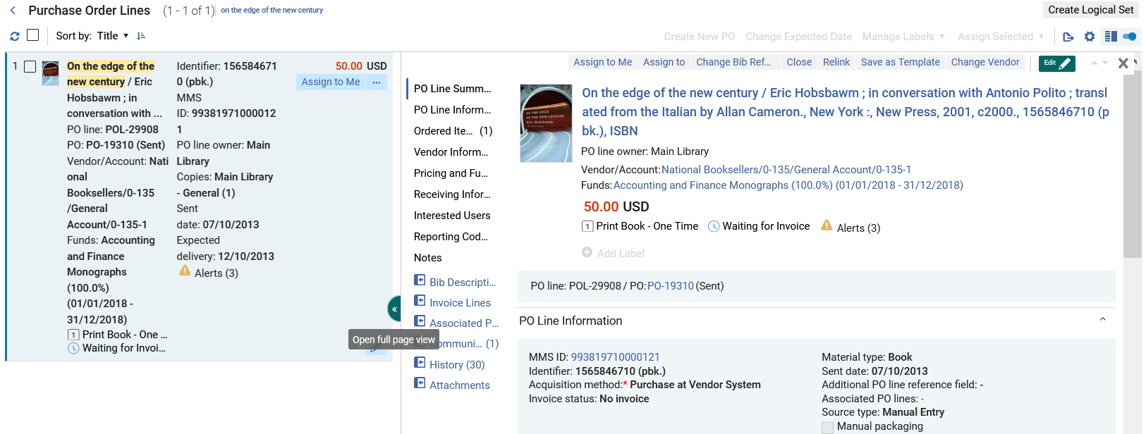
Presentation Toggle Button
Click the “Disable split screen” button on top right
Click the “Open full page view” in the middle of the screen

Slide 66
Presentation Toggle Button
There are three ways to get to the split screen view from the full-page view
Click the X (close) on the top right
Click the “Return to split view” icon on the left
Click the “Back to list” link on top left

Slide 67
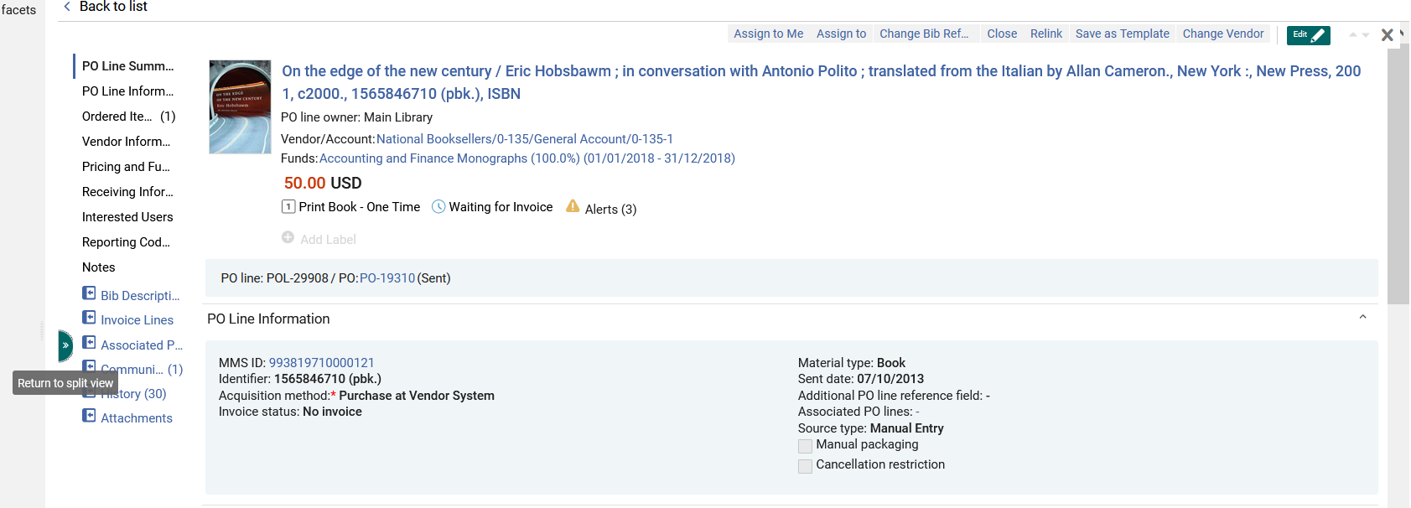
Presentation Toggle Button
Click the “Back to list” link on top left
Click the X (close) button on top right
Click the “Return to split view” in the middle of the screen

Slide 68
Split View (Side By Side View)

Slide 69
Split View (Side By Side View)
To improve the usability of the unified PO line task list, a "Side By Side View" presentation enables users to view a list of PO lines on one side and detailed information regarding the selected PO line on the other side.
The right panel holds relevant information regarding the PO line, for users with relevant roles.
This information is editable from the panel itself, preventing users from the need to navigate to a specific PO line editing screen.

Slide 70
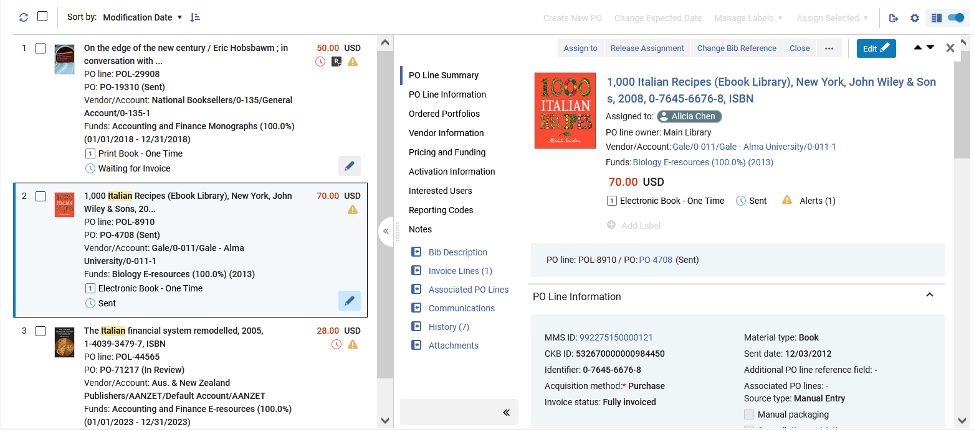
Split View (Side By Side View)
Editable POL details will open in the Right side panel
Select a POL from the Compact left side record view

Slide 71
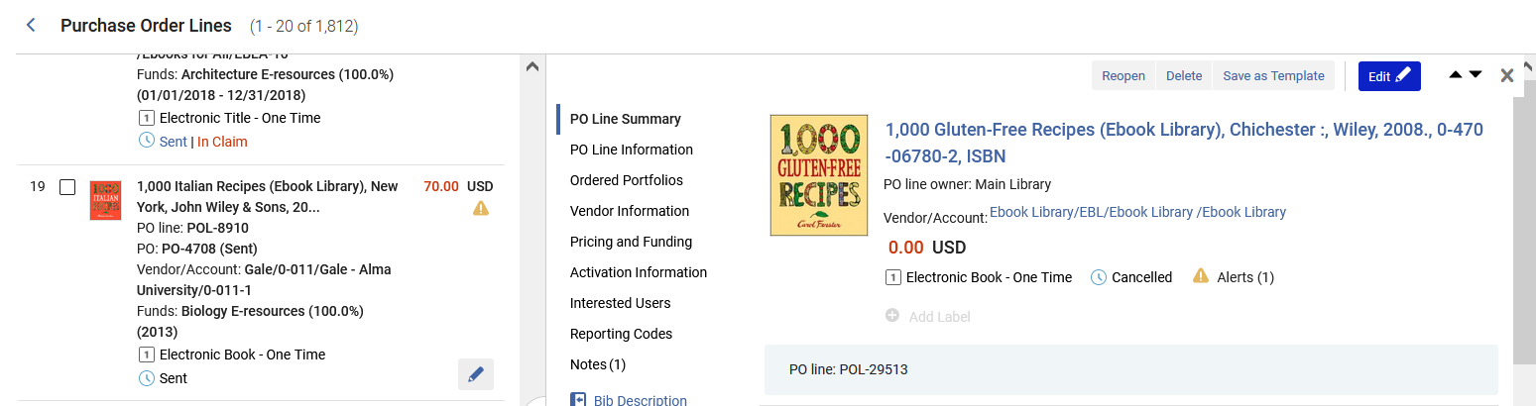
Split View (Side By Side View)
A dedicated “Edit” button has been added to the left panel, to save users from the need to access the right panel (or full view) and click “Edit” there:
Click also click here to edit
Click here…

Slide 72
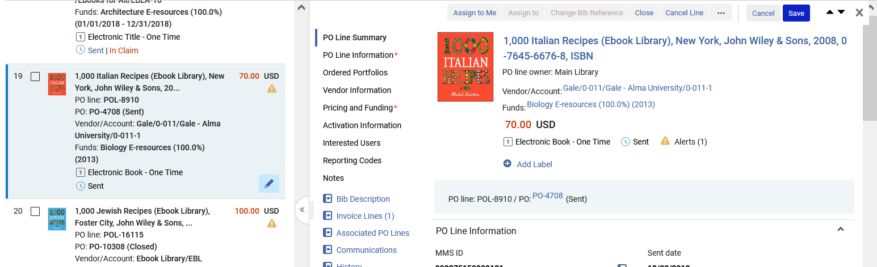
Split View (Side By Side View)
In the right pane the PO Line will already be in edit mode:
PO Line can be edited and saved

Slide 73
Split View (Side By Side View)
Navigate the POL via the sections or the scrollbar.
Or use the scroll bar

Slide 74
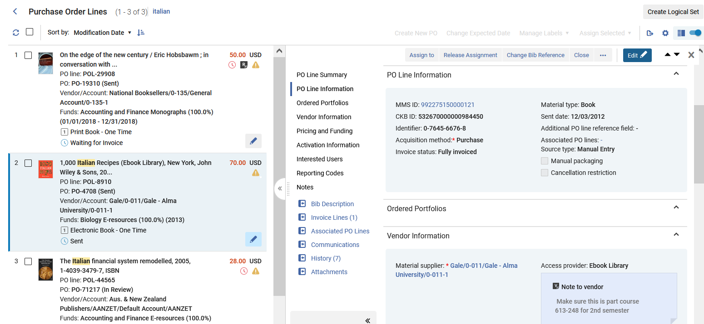
Split View (Side By Side View)
The POL can be edited in the right-side panel.

Slide 75
Split View (Side By Side View)
Both the Functional as well as Informative actions may be accessed on the POL in the right-side panel.
  Functional actions include "Assign To", "Change Bib Reference", "Close" and "Relink".
  Informative Actions include "Bib Description", "Invoice Lines", Associated PO Lines", "Communications", "History" and "Attachments".

Slide 76
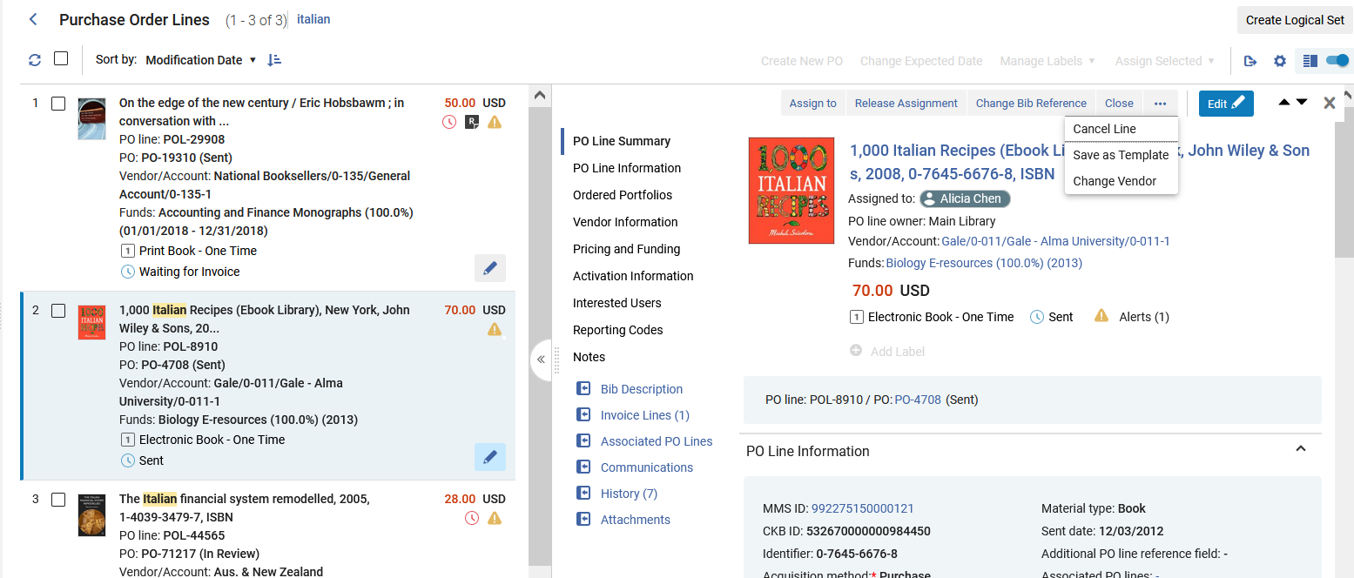
Split View (Side By Side View)
Functional and informative actions may be taken on the POL in the right side panel.
Functional actions
Informative actions

Slide 77
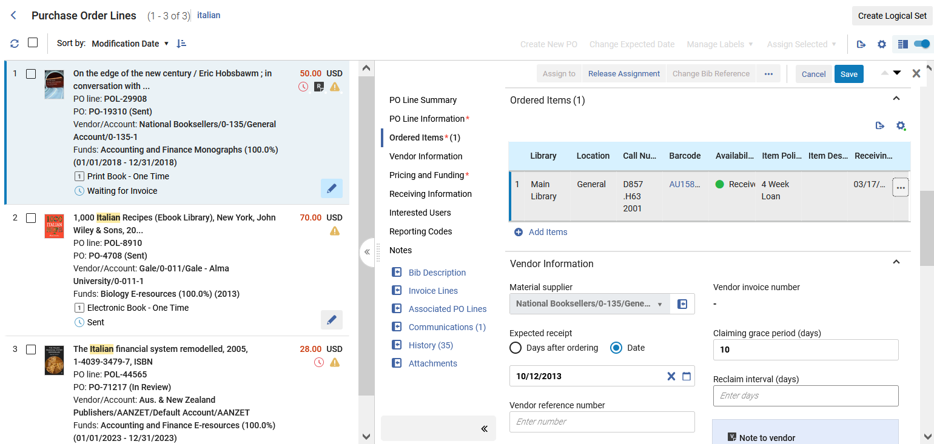
Split View (Side By Side View)
Note that the column containing the sections and information actions can be collapsed
Collapse the column

Slide 78
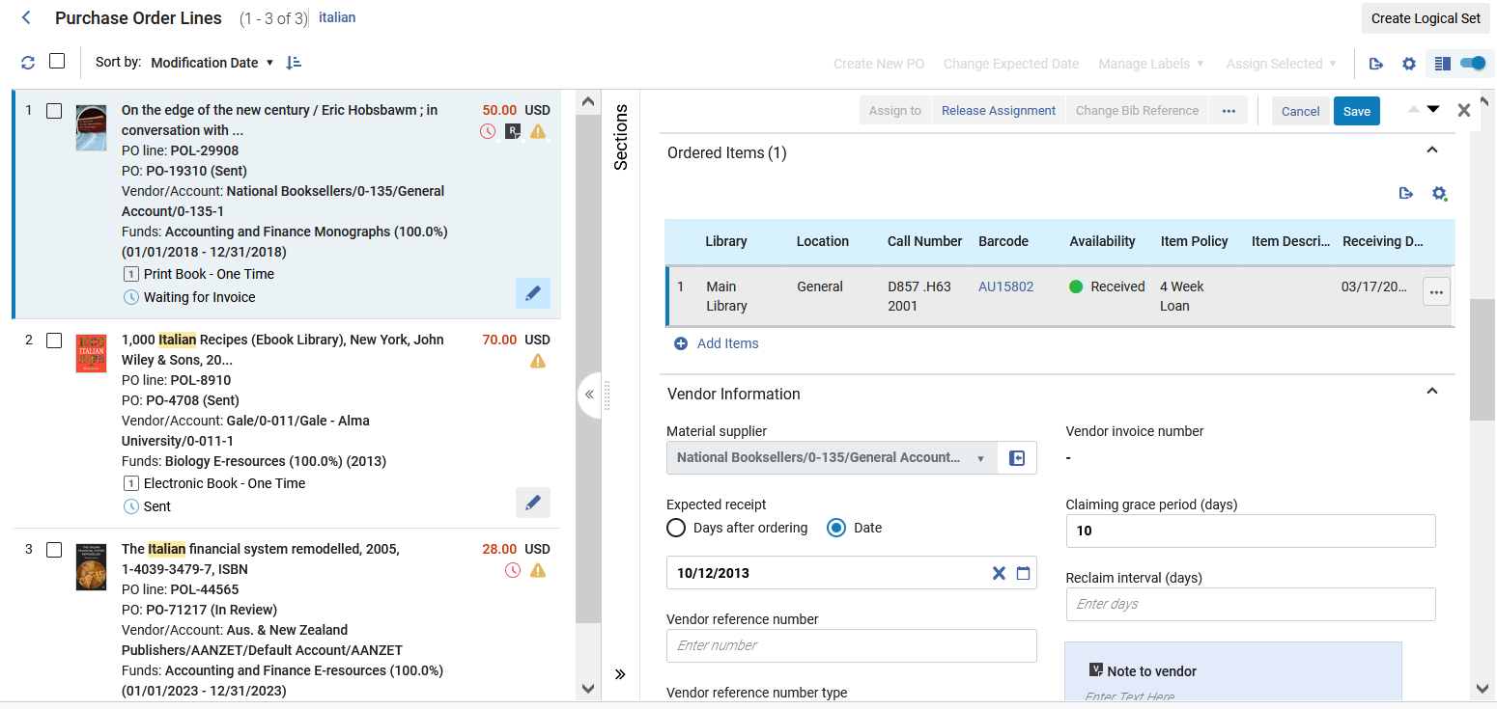
Split View (Side By Side View)
The column is now collapsed
Open the column

Slide 79
Slide-Out Panel

Slide 80
Slide-Out Panel
The slide out panel enables the staff user to access entities which relate to the PO line while keeping the PO line in the background at all times.
For example, staff users who work on a PO line and would like to view/modify the information of the item associated with the PO line can click on the ellipsis (...) action located at the "Ordered Items section" and from there navigate to a sliding panel which holds the item's information.
To close the panel users can either save the item or click on the "X" icon to close it. The sliding panel is used for displaying multiple entities while working on a PO line.

Slide 81
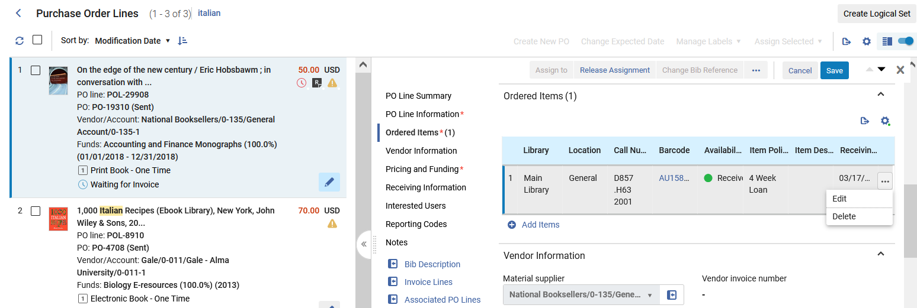
Slide-Out Panel
We will click now the "edit" link in the "Ordered Items" section

Slide 82
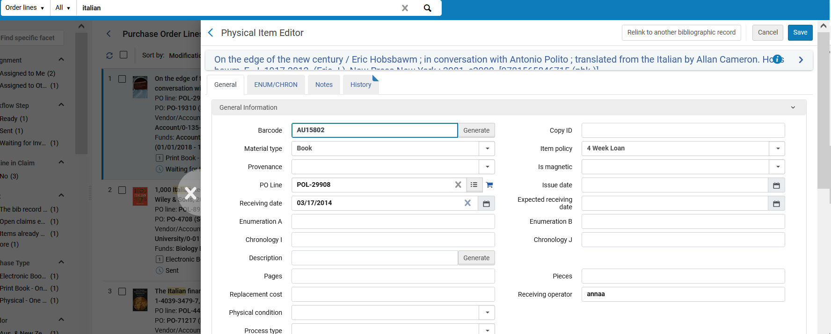
Slide-Out Panel
The Physical Item editor slides out in a new panel
Close the panel here

Slide 83
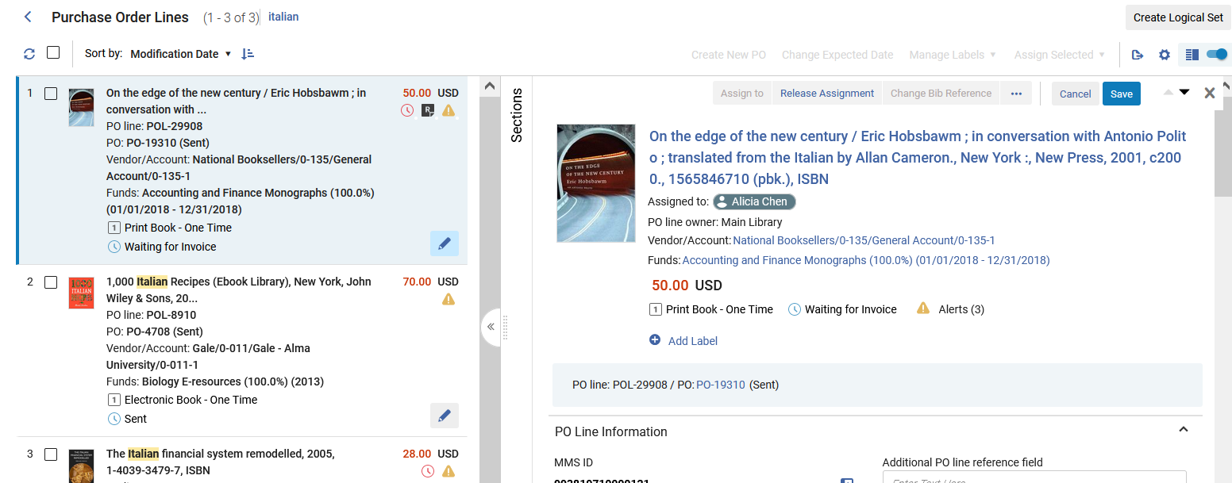
Slide-Out Panel
We will click now the link to the PO

Slide 84
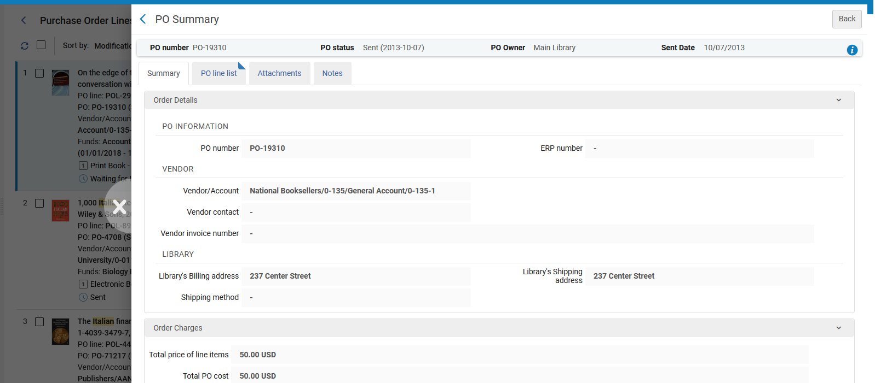
Slide-Out Panel
The PO slides out in a new panel
Close the panel here

Slide 85
Receiving Items from within the PO Line

Slide 86
Receiving Items from within the PO Line
It is possible to receive items for a PO Line directly from within the POL.
This saves time, preventing the staff user from needing to navigate to the Receiving Workbench in order to receive the item.
The staff user does not need to exit the PO Line and click the "Receive" link under the "Actions > Receiving and Invoicing" section of the menu.

Slide 87
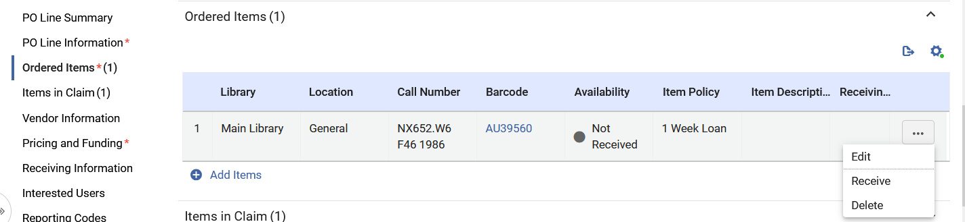
Receiving Items from within the PO Line
Here we are in a PO Line in the "Ordered Items" section.
We will click "Receive" for item barcode AU39560

Slide 88


Receiving Items from within the PO Line
We then get a confirmation message to approve and then a message that the receiving process was activated.

Slide 89

Receiving Items from within the PO Line
There is then an indication in the PO Line that the item was received

Slide 90
PO Line Actions Sensitive to Workflow Step

Slide 91
PO Line Actions Sensitive to Workflow Step
PO line actions in both the left and right panels are sensitive to the workflow step of the PO line.
As a result, different PO Lines may have different Main Actions depending on the workflow step.

Slide 92
The "Items In Claim" Section

Slide 93
The "Items In Claim" Section
When a PO Line for physical inventory is In Claim the PO Line will have the regular section "Ordered Items" and also a section "Items in Claim".
This is particularly useful when there are multiple items being ordered and only some of them are in claim.
It allows the staff user to quickly and easily identify the items which already arrived or are expected to arrive in the future, and the items which are still claimed.

Slide 94

The "Items In Claim" Section
Here is a PO Line for one item and the PO Line is In Claim
In this case the same item appears in both sections

Slide 95

The "Items In Claim" Section
Here is a PO Line for two items and the PO Line is In Claim and one item has already arrived
Two items were ordered, and one arrived
This is the one claimed item

Slide 96
The Clickable "Sent" Status

Slide 97
The Clickable "Sent" Status
As part of a major improvement in navigation, the "Sent" status is clickable and sensitive to the inventory type of the PO Line.
Clicking on "Sent" for PO Lines with physical material will bring the user to the Receiving Workbench.
Clicking on "Sent" for PO Lines with electronic material will bring the user to the Electronic Resource Activation Task List.
This saves the user several navigation clicks.

Slide 98

The Clickable "Sent" Status
Here is a PO Line for physical inventory in workflow step "Sent"
Hovering over the "Sent" link gives a pop-up text "Show PO Line in the Receive New Material Screen"

Slide 99

The Clickable "Sent" Status
Clicking the "Sent" link brings us to the Receiving Workbench already filtered for the PO Line from which we came.

Slide 100

The Clickable "Sent" Status
Here is a PO Line for electronic inventory in workflow step "Sent"
Hovering over the "Sent" link gives a pop-up text "Show PO Line in the Electronic Activation Task List Screen“. Clicking “Sent” will open the Electronic Activation Task List Screen if the resource has an electronic activation task

Slide 101

The Clickable "Sent" Status
Clicking the "Sent" link brings us to the PO Line Activation Task List screen filtered by the POL from which we came.

Slide 102
Sorting and Labels

Slide 103

Sorting and Labels
It is possible to sort PO Lines by a variety of parameters
Here the user can change the sort to ascending or descending

Slide 104

Sorting and Labels
The sort here is by title ascending

Slide 105

Sorting and Labels
It is possible to add customized labels to the PO Lines

Slide 106

Sorting and Labels
Now we have added two labels to the PO Line

Slide 107

Sorting and Labels
When a label already exists, it can be added by typing just a part of the label and then choosing it

Slide 108

Sorting and Labels
The labels appear in the list of PO Lines

Slide 109

Sorting and Labels
The labels can also be added or removed in bulk

